Slide 1


Slide 2
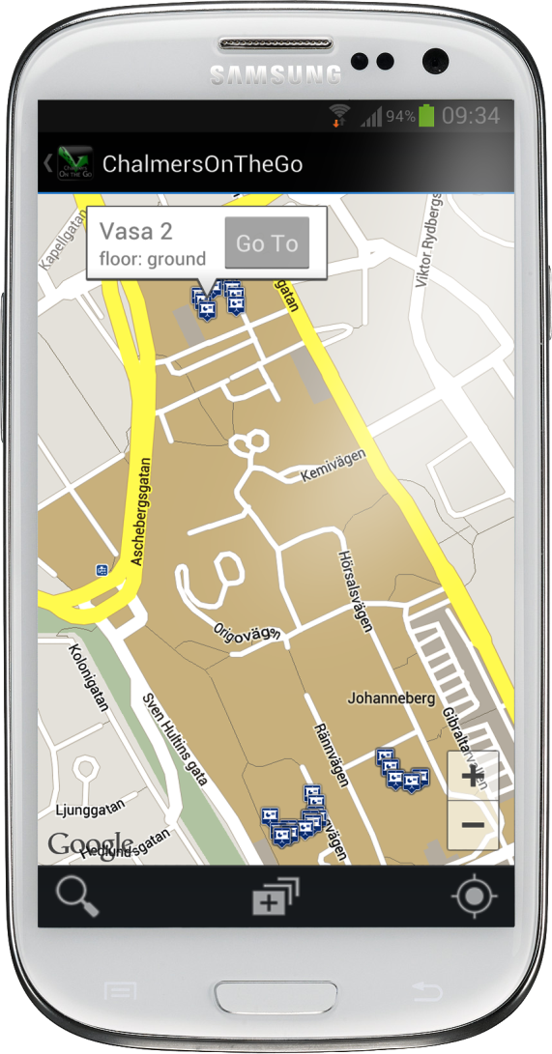
Chalmers on the go
Never get lost again
Enhanced map
The Complete Chalmers Experience- Right at your fingertips!

Slide 3
Agenda
Development
Initial Idea
Scrum
User Stories
Testing
Project Burndown
Application Core Features
Search interface
Layer function
Navigation
Intuative GUI
Demo
Google Maps™ v2.0 API
Product demo live
Notes:
Kanske lägga till testdriven development osv?

Slide 4
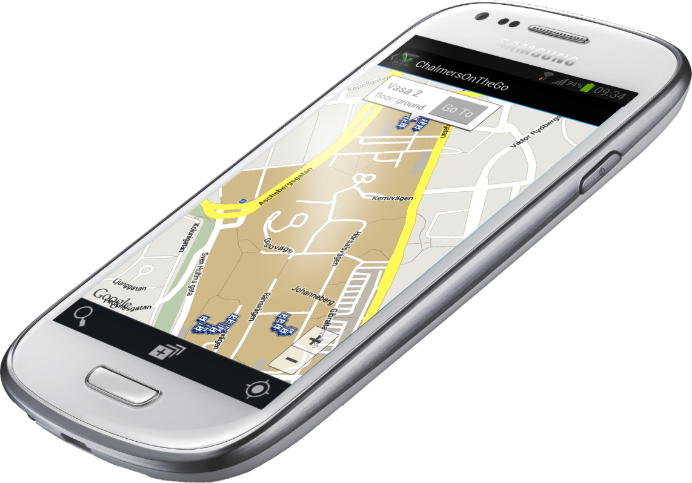
Development

Slide 5
Initial Idea
Application
The complete chalmers experience as a map

Slide 6
Initial Idea
Application
Adding all things that are important to a student on a map
Lecture halls
Computer rooms
Group rooms
Pubs
Spare time activities
Never get lost - Always know where you are heading

Slide 7
Scrum and XP
Development
Monday
Sprint startup
Wednesday
Scrum meeting
Work
Friday
Scrum meeting
Work
Work

Slide 8
User Stories
Development
As a user, I want to….
… search for buildings and the result should be all rooms.
…have a Checkbox Menu in which i can choose between different types of rooms, and show all.
…see the distance and duration between two points.
…see only the Chalmers area on the map.
…be able to navigate to a arbitrary position on the Chalmers area.
Notes:
Change first userstory,type thing

Slide 9
Testing
Development
Acceptance
Functionality
Graphical
JUnit
Database
Notes:
more than 50 acc tests

Slide 10
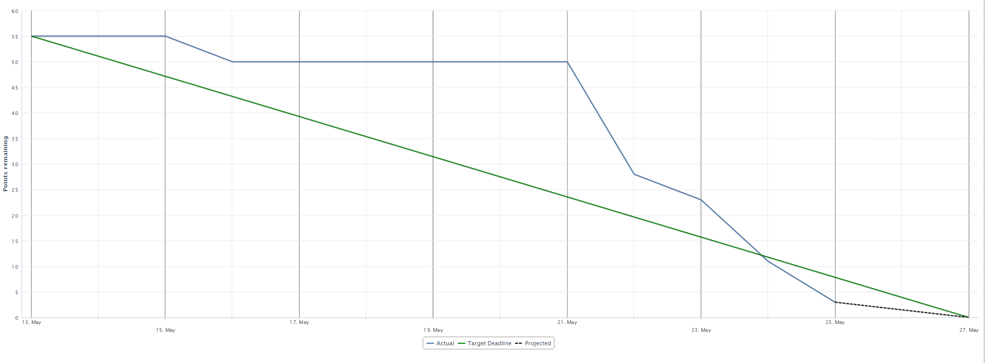
Project burndown
Development
Delayed first
Quick recovery
Avg velocity 60p/week
Notes:
Recov started 21 of may
On schedule 24de

Slide 11
Users
Development
Students at Chalmers University of Technology
Guests at chalmers
Tutors
Anyone having to find their way arround Chalmers

Slide 12
Application

Slide 13
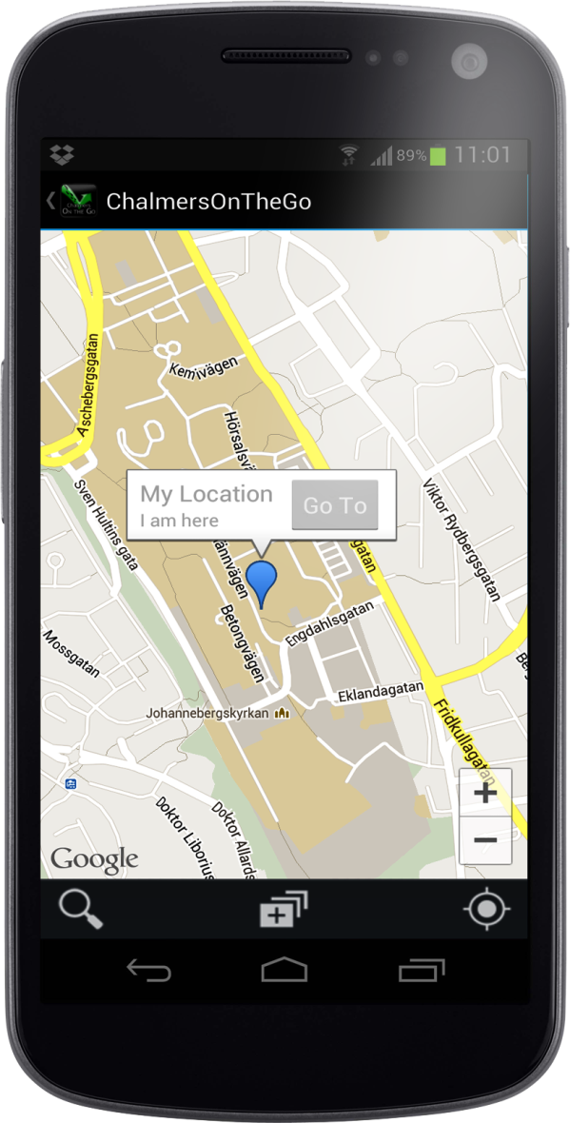
Core Features
Application
Search interface
Layer function
Navigation
Intuative GUI
Notes:
Database: About 800 lines of code.

Slide 14
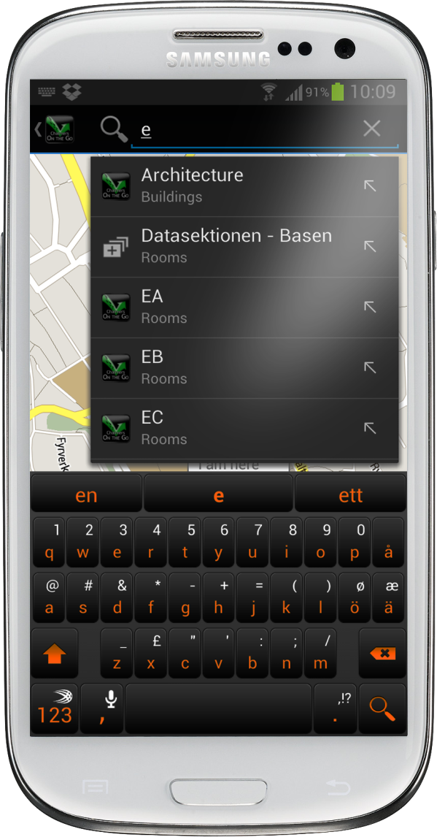
Core Features
Application
Search Interface
Search suggestions
Smart search
Logos on search
Scrollable menu

Slide 15
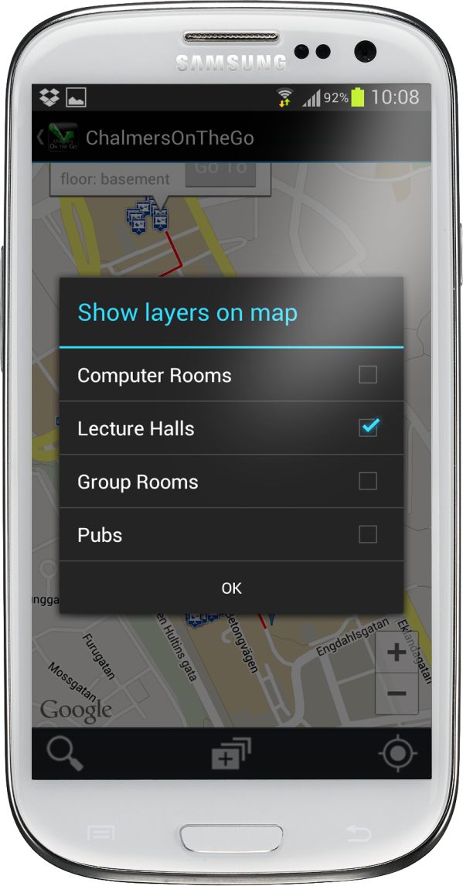
Core Features
Application
Layer function
Show all of specific types
Select visible floors

Slide 16
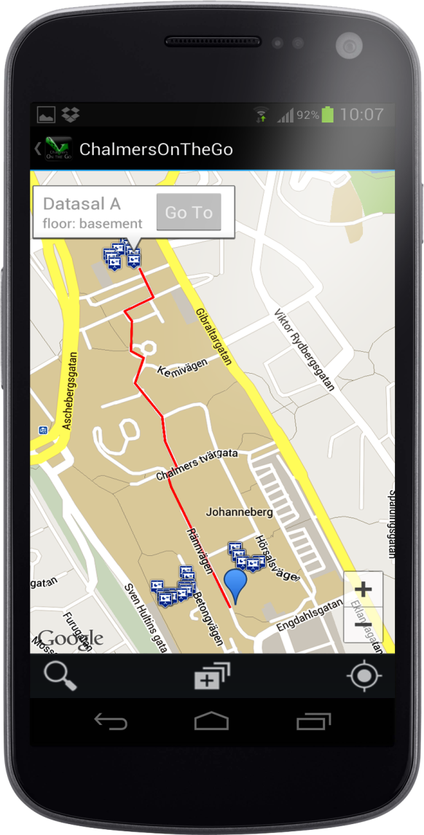
Core Features
Application
Navigation
Easily navigate to a point of interest
Navigate between two separate locations
Get distance and duration to walk
Notes:
Ändra Bilden till den med distance och duration och goto

Slide 17
Core Features
Application
Navigation
Navigate to and from with suggestions
Add your own marker by press and hold
Shortest path always
Notes:
Ändra bilden till search interfacet med suggestions

Slide 18
Just one more thing…

Slide 19
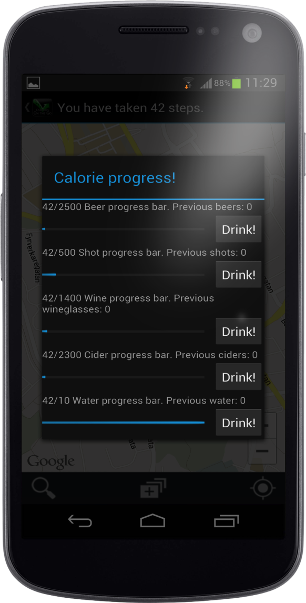
Step Counter
Just one more thing…
Track your steps
Breaking down the steps into beers, ciders, wine, shots or water
Keeping track of what you have taken
Never get fat again

Slide 20
Demo

Slide 21

Google Maps™ API
Development
Provided the map
Import using a key

